Slide 1


Social Pulse

Slide 2


Today's agenda
Project recap
Problem
The Analytics team
Process
Insights
Summary

Slide 3

Social Buzz is a rapidly growing company that needs quickly to adapt the global environment.
The 3 Main tasks performed by Accenture:
Audit of Social Buzz big data practice
Recommendation for successful IPO
Analysis to find top 5 categories of content on Social Buzz data sets.
Project Recap

Slide 4

Problem
The Company has a large amount of data and want a well-known firm to perform data analysis on their big data and provide meaningful insights.
The project was aimed to get the top 5 categories of content based on the scores of content type.

Slide 5



Andrew Fleming
Chief Technology Architect
The Analytics team
Marcus Rompton
Senior Principal
Pratham Patel
Data Analyst

Slide 6
Process
1
Understanding the Data in the Data Sets
2
Cleaning the Data Sets
3
Data Modeling
4
Data Analysis
5
Uncover Insights

Slide 7

Insights
16 Unique
Categories
Top Category:
Technology
Highest Post Month:
November

Slide 8
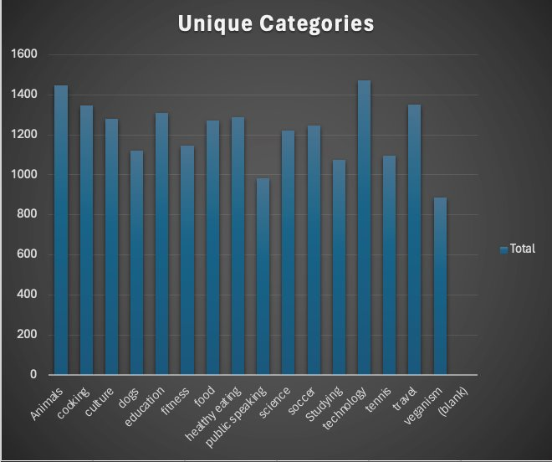

Slide 9
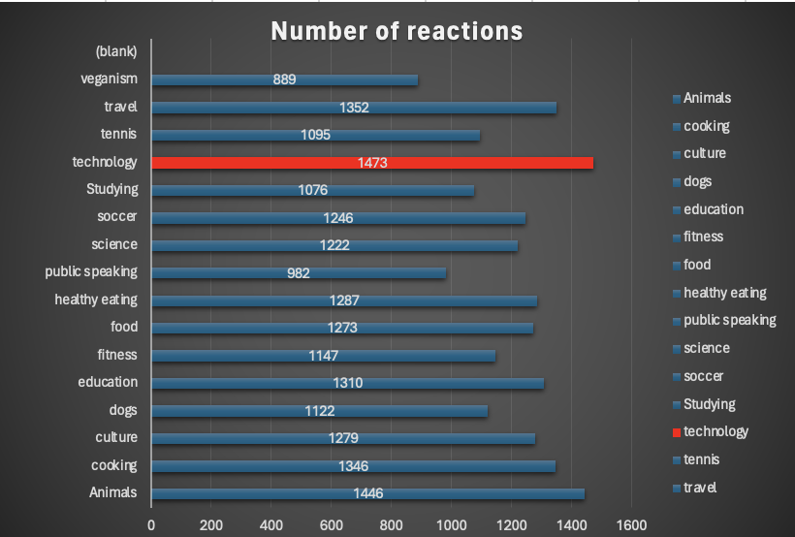

Slide 10
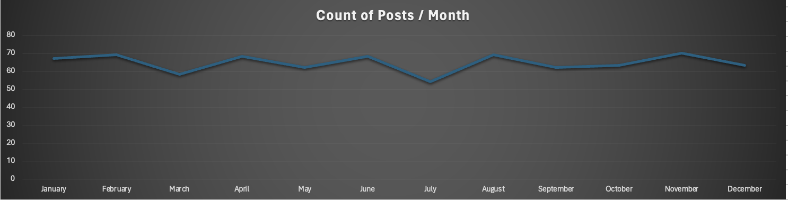

Slide 11

The project aims to analyze the data of a company named Social Buzz to identify the top five categories of content within their dataset.
Social Buzz is a company that operates in the realm of social media or online content creation and distribution. The dataset likely includes various metrics such as engagement, reach, likes, shares, comments, and possibly textual or multimedia content.
Result :
The top 5 Categories of content after analysis are :-
Technology
Animals
Education
Travel
Healthy Eating
Summary

Slide 12
Thank you!
ANY QUESTIONS?

